Slide 1
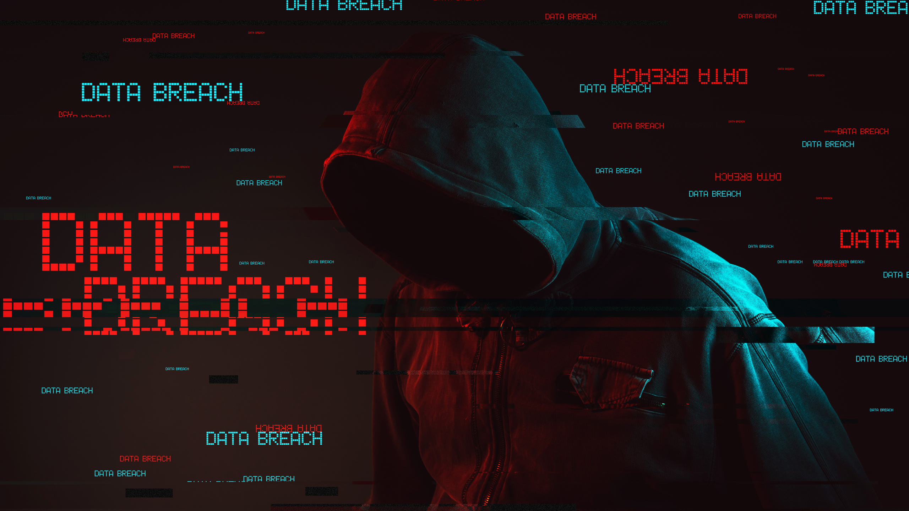
Hacking

Slide 2


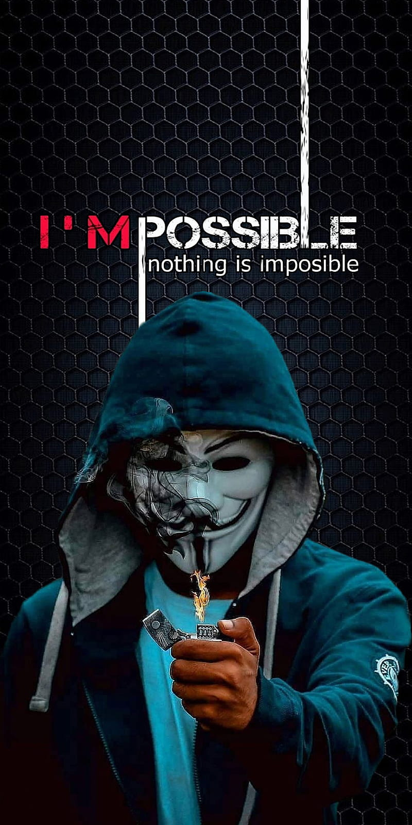
INDEX OF THE PRESENTATION
What hacking really means
Different kinds of hackers exist!
The origin of «hacker»
The first hacker in history
Kevin Mitnick
«Hacktivist» , the beginning of a new era

Slide 3

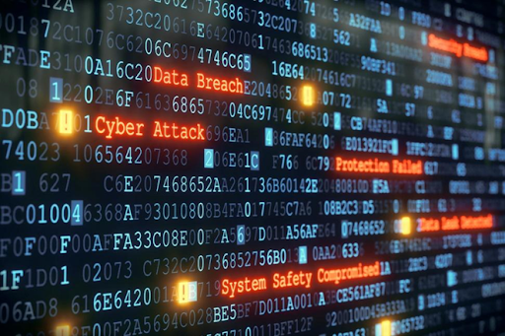
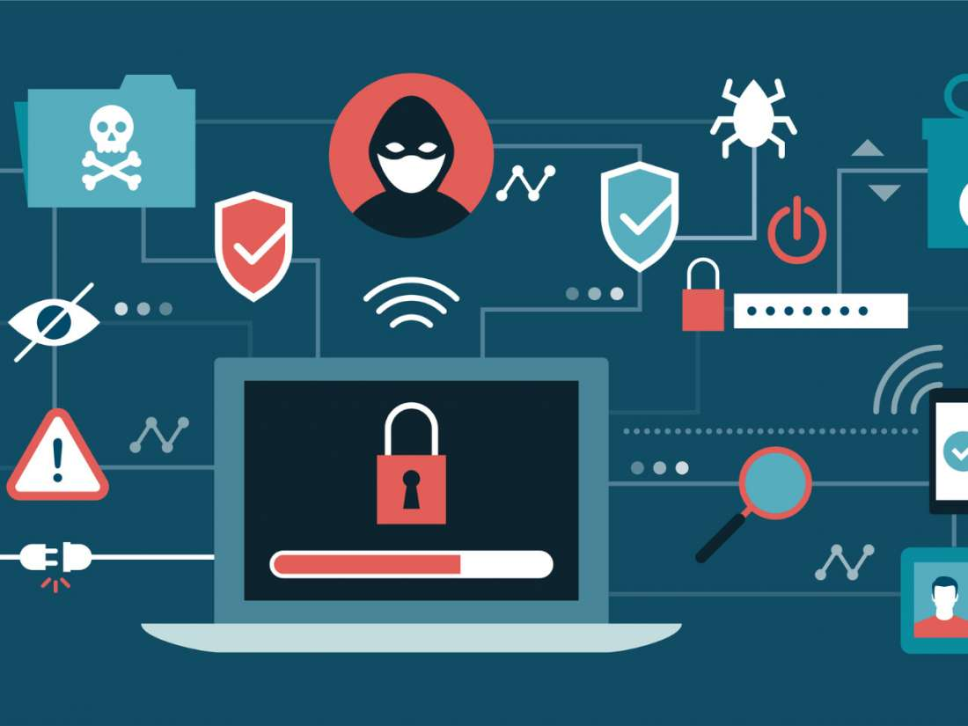
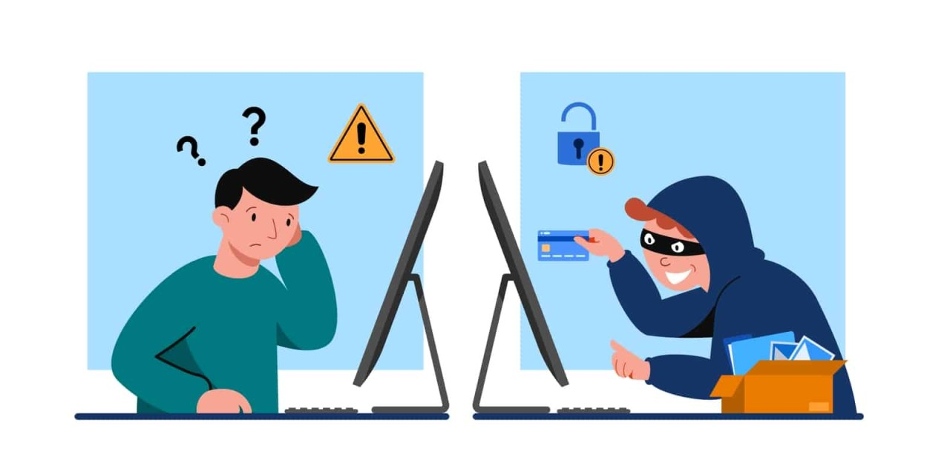
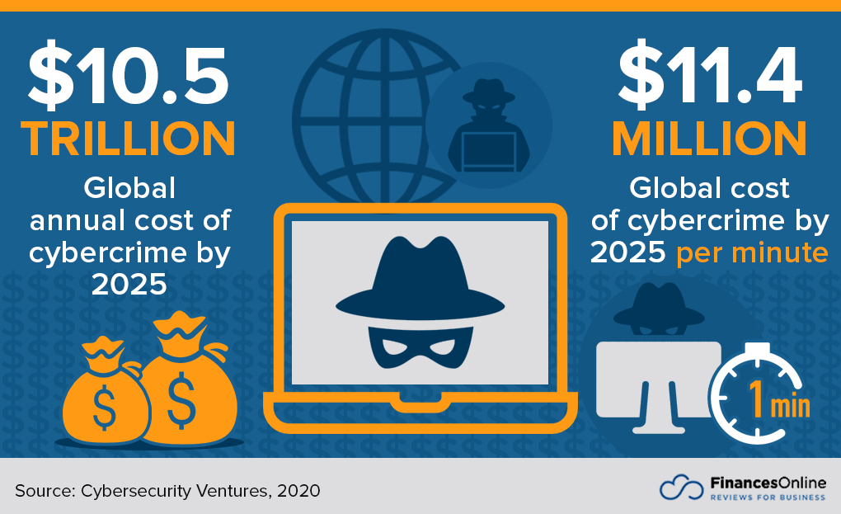
Hacking
Legitimate purposes or illegal behavior
Technological knowledge
Security violation
Social engineering
World’s third largest economy
Everyone could be considered as an hacker

Slide 4

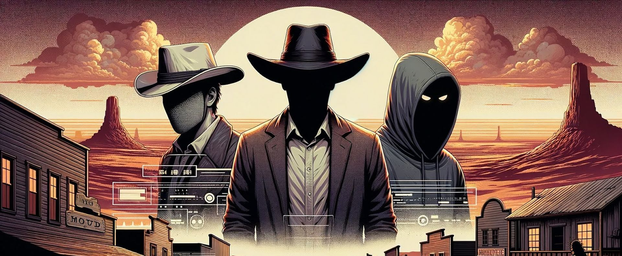

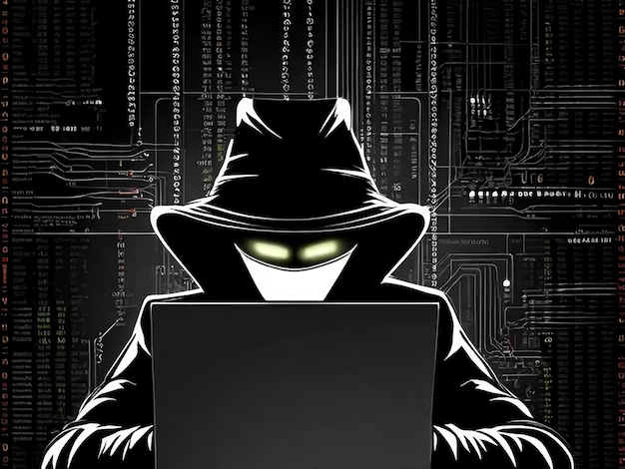
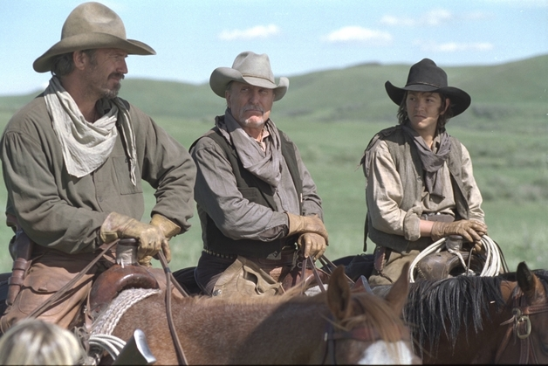

Who hackers are?
White hat
Black hat
Grey hat

Slide 5

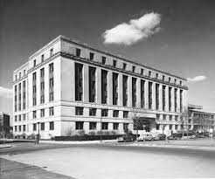
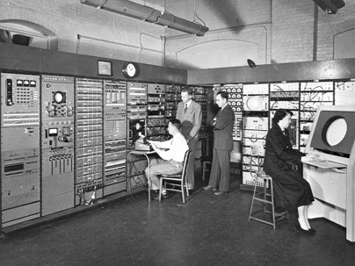
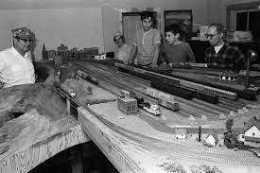
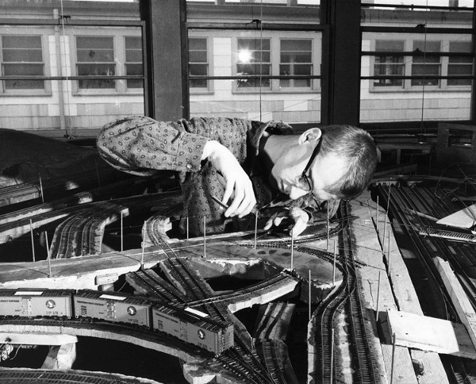
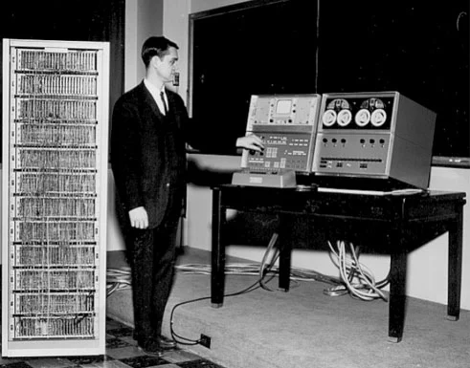
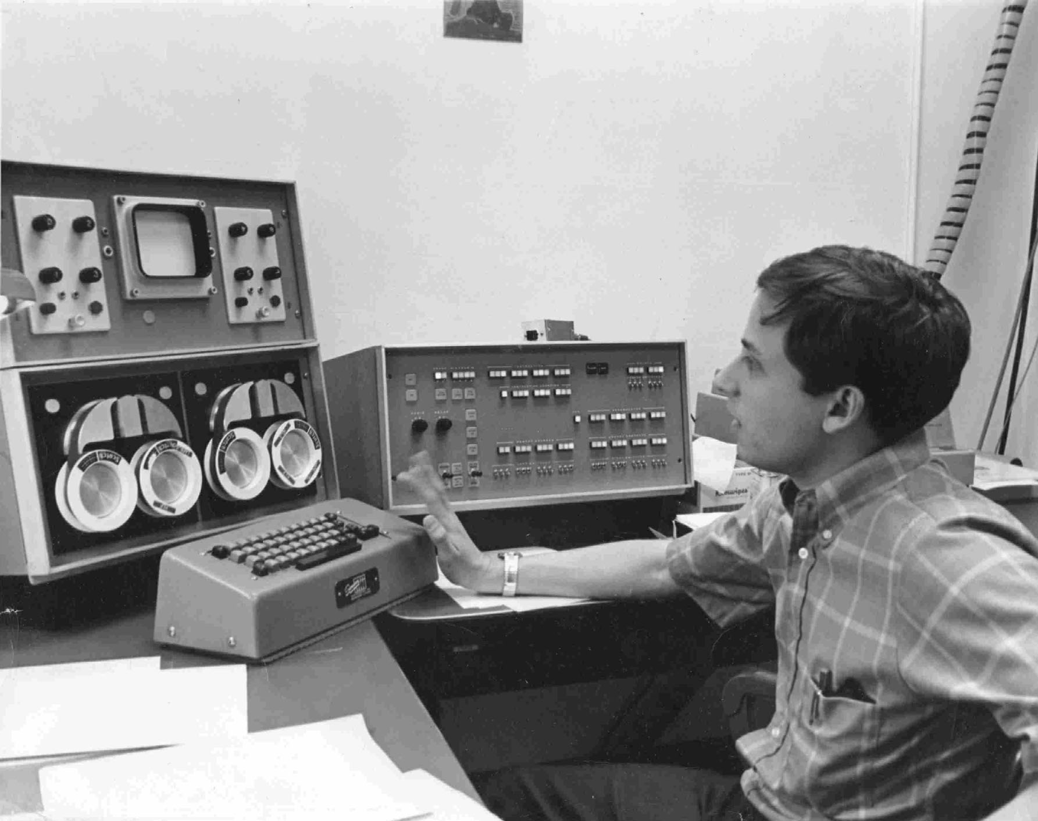
Origin of the word «Hacker»
1950, MIT institute
Tech Model Railroad Club
The digital approach

